Slide 1

JS
JavaScript
Presented BY Steve Lourenco

Slide 2
Last Week
CSS Layouts
CSS Framework: Bootstrap 4

Slide 3
Why DO WE NEED Javascript?
HTML defines the content
CSS specifies the layout of a webpage
JavaScript allows us to program the behavior of a web page

Slide 4
WHERE CAN WE USE JAVASCRIPT?
Client side validation (verify any user input)
Manipulating HTML Pages (change the content of an HTML tag)
User Notifications (raise dynamic pop-ups on the webpages to give different types of notifications to your website visitors)
Back-end Data Loading (AJAX) : (Instead of loading content by loading the whole page, we can se AJAX to load asynchronously content)
Server Applications (Nodejs, is a Javascript Server. We can compare with Rails. Rails is a ruby server.)

Slide 5
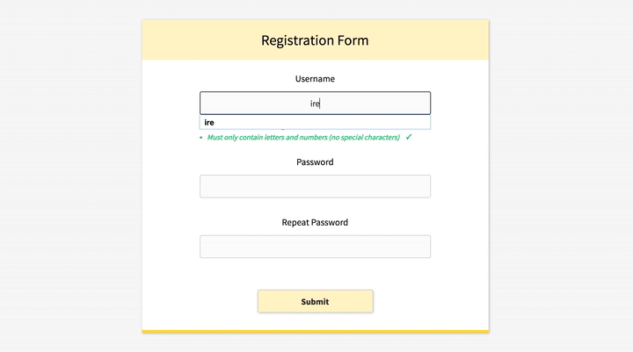
Advantages of JavaScript
Less server interaction (validate user input before sending the page off to the server)
Immediate feedback to the visitors (don't have to wait for a page reload to see if they have forgotten to enter something)
Richer interfaces (You can use JavaScript to include such items as drag-and-drop components and sliders to give a Rich Interface to your site visitors
https://apvarun.github.io/toastify-js/#

Slide 6
WHERE TO INSERT
In HTML, JavaScript code must be inserted between <script> and </script> tags.
https://www.w3schools.com/js/tryit.asp?filename=tryjs_whereto
Scripts can be placed in the <body>, or in the <head> section of an HTML page
Example with the script in the head tag: https://www.w3schools.com/js/tryit.asp?filename=tryjs_whereto_head
Example with the script in the body tag: https://www.w3schools.com/js/tryit.asp?filename=tryjs_whereto_body
Scripts can also be placed in external files
Example: <script src="myScript.js"></script>
https://www.w3schools.com/js/tryit.asp?filename=tryjs_whereto_external
External scripts cannot contain <script> tags

Slide 7
Display Possibilities (Most important)
Writing into an HTML element, using innerHTML
Writing into an alert box, using window.alert() → You can use an alert box to display data:
Writing into the browser console, using console.log()

Slide 8
innerHTML
To access an HTML element, JavaScript can use the document.getElementById(id) method
Document → Means the webpage
getElementById → Allow us to find an HTML element by ID
ID → Enter the ID name of your element
innerHTML → Defines the HTML content
https://www.w3schools.com/js/tryit.asp?filename=tryjs_output_dom

Slide 9
Statements
alert(“Wake up!”) is a statement
No limits of statements
Add a semicolon at the end of each executable statement:
JavaScript Code Blocks: JavaScript statements can be grouped together in code blocks
JavaScript Keywords: statements often start with a keyword to identify the JavaScript action to be performed: https://www.w3schools.com/js/js_reserved.asp

Slide 10
VARIABLES
Javascript allows us to work with data. Here are three primitive data types:
Number
String
Boolean
JS allows us to store those data types in variables
var name = "Ali"; → Store the string ALI in the variable name
Another example:
var money;
money = 2000.50;

Slide 11
Variable scopes: Global VS LOCAL
Global variable: A global variable has global scope which means it can be defined anywhere in your JavaScript code.
Local Variables − A local variable will be visible only within a function where it is defined. Function parameters are always local to that function.
You can call a global variable inside a function but you can’t call a local variable outside of the function.

Slide 12
oPerators
Arithmetic Operators
Comparison Operators
Logical (or Relational) Operators
Assignment Operators
Example: https://www.tutorialspoint.com/javascript/javascript_operators.htm

Slide 13
IF … ELSE
With help of operators, we can now create conditions which can only be executed if true
Example:
https://www.tutorialspoint.com/javascript/javascript_ifelse.htm
Others: https://www.tutorialspoint.com/javascript/javascript_switch_case.htm

Slide 14
For LOOP
The for loop has 3 parameters
loop initialization → We initialize our counter
test statement → test if a given condition is true or not
iteration statement → increase or decrease rule of the counter
Others: https://www.tutorialspoint.com/javascript/javascript_forin_loop.htm

Slide 15
WHILE Loop
The purpose of a while loop is to execute a statement or code block repeatedly as long as an expression is true. Once the expression becomes false, the loop terminates.
Possible to create a infinite loop → while (true) { }

Slide 16
Functions
group of reusable code which can be called anywhere in your program
eliminates the need of writing the same code again and again
allow a programmer to divide a big program into a number of small and manageable functions
To invoke the created function somewhere later in the code, you just need to write the name
→ sayHello();

Slide 17
EVENTS
JavaScript's interaction with HTML is handled through events that occur when the user or the browser manipulates a page.
When the page loads, it is called an event. When the user clicks a button, that click too is an event. Other examples include events like pressing any key, closing a window, resizing a window, etc.
https://www.tutorialspoint.com/javascript/javascript_events.htm

Slide 18
onclick Event Type
most frequently used event type

Slide 19
MORE EVENTS
https://www.tutorialspoint.com/javascript/javascript_events.htm

Slide 20

Thank You!
Lourenco.steve@outlook.com

